Slide 1

National University of Computer and Emerging Sciences,
Islamabad, Pakistan
Machine Learning Basics
DS-5006 Deep Learning
Dr. Noshina Tariq
Department of Computer Science

Slide 2
Goals
Review of Previous Lecture
Today’s Lecture
Machine Learning Overview
Linear models
Loss functions, linear regression, gradient descent, overfitting, underfitting generalization, regularization, cross-validation

Slide 3
Recap of Previous Lecture

Slide 4
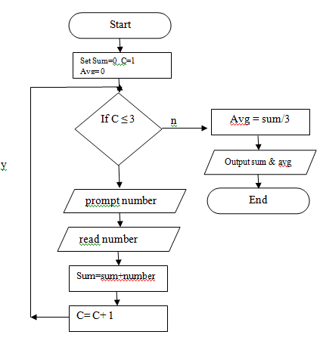
What is Learning?
How can we solve a specific problem?
We write a program with a set of rules that are useful to solve the problem.
Example: Find average of
three numbers

Slide 5
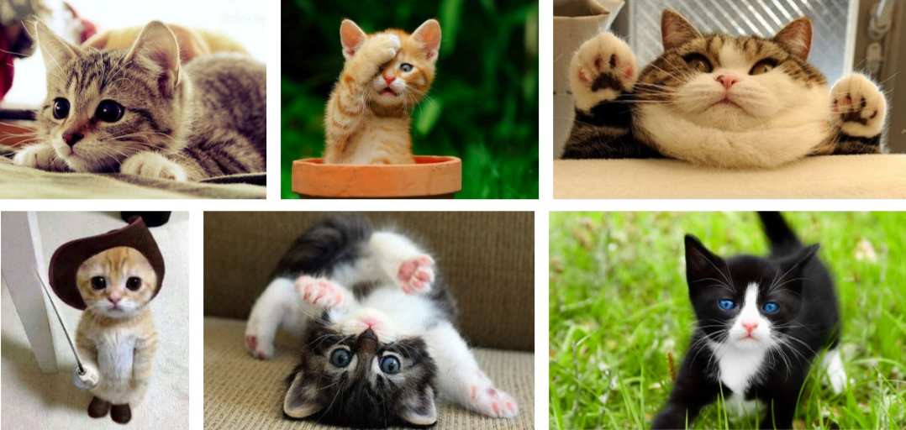
What is Learning?
In many situations it is very difficult to specify those rules to solve a problem.
For example, given a picture determine whether there is a cat in the image
Writing explicit rules (“whiskers + ears + tail = cat”) is difficult.
Variations exist: cats in different poses, colors, costumes, or angles.
Humans recognize objects (like cats) by observing features.
Machine Learning: learns patterns directly from data (examples).
Generalizes from examples → can identify new images as cats.
Analogy: teaching a child by showing pictures, not by giving rulebooks.

Slide 6
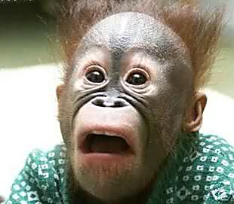
What is Machine Learning?
Definition: “A computer program is said to learn from experience E with respect to some class of tasks T and performance measure P, if its performance at tasks in T, as measured by P, improves with experience E”
Tom M. Mitchel

Slide 7
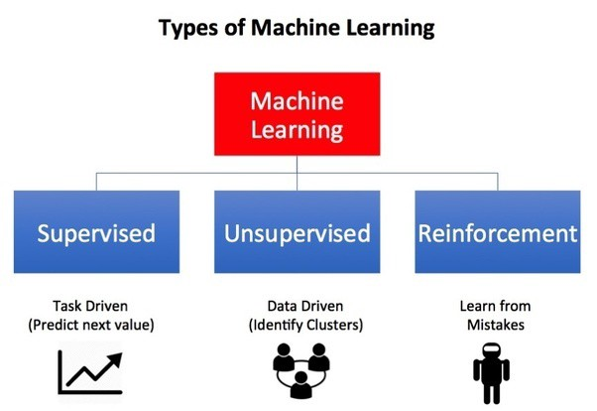
Types of Machine Learning…

Slide 8
Today’s Lecture

Slide 9
Machine Learning Basics
Machine learning is a subset of artificial intelligence (AI)
Development of algorithms that enable computer systems to learn through learning from data
Improve their performance on a specific task with experience
No explicit programming (Rules-based not hard-coded)
Example: spam detection → model learns from labeled emails instead of fixed rules
Deep learning is a specific kind of machine learning.
To understand deep learning well, one must have a solid understanding of the basic principles of machine learning.
Learns complex features automatically (e.g., images, speech, text)
Example: self-driving cars → deep learning helps recognize pedestrians, traffic lights, etc.
Key Principle: 👉 The system “learns through data” rather than being told all rules step by step.

Slide 10
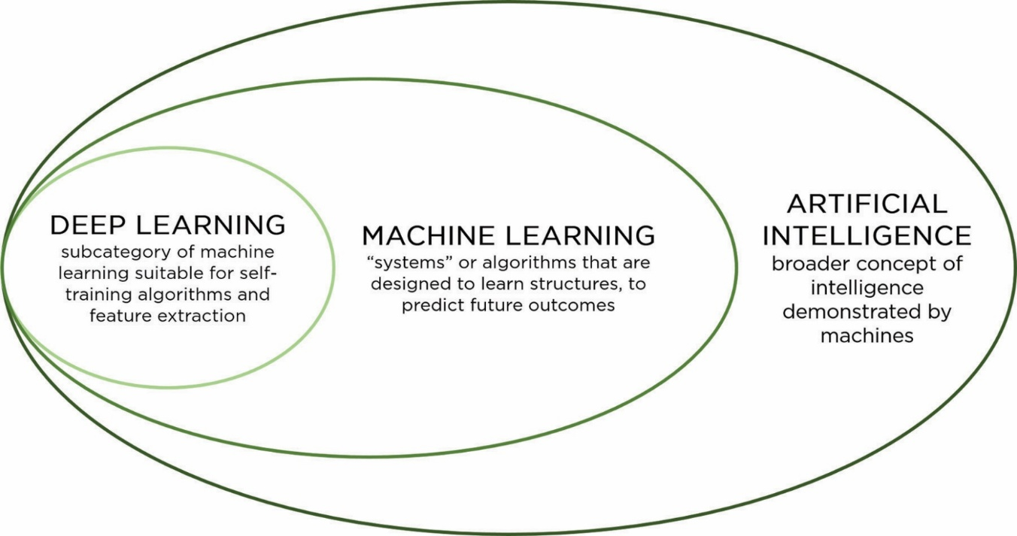
Artificial Intelligence (AI)
Broadest field → making machines mimic human intelligence.
Includes reasoning, problem-solving, decision-making, language, vision.
Example: Chess-playing programs, Siri, autonomous cars.
Machine Learning (ML)
Subset of AI.
Focuses on systems that learn patterns from data and improve performance.
Example: Spam filters, recommendation systems (Netflix, YouTube).
Deep Learning (DL)
Subset of ML.
Uses multi-layered neural networks for automatic feature extraction.
Especially powerful in images, speech, natural language.
Example: Face recognition, ChatGPT, self-driving car vision.
Question:
If AI is the big circle, where do ML and DL fit in? Can you think of an AI example that is not ML?

Slide 11
Machine Learning
Different algorithms (Decision Trees, SVM, Neural Networks) fit data in different ways.
Example: linear regression draws a line, decision tree splits rules.
Models can have many hyperparameters
Settings chosen before training (like learning rate, tree depth, number of layers).
These affect model performance a lot.
Learning algorithm statistically estimate complicated functions to learn about data
ML is about approximating the hidden relationship between input (X) and output (Y).
Example: predicting house price from size, location, rooms.
Uses some optimization algorithm to learn about data, most widely used algorithm called gradient descent.
The main optimization method in ML/DL.
Idea: keep adjusting parameters step by step to minimize error (like walking downhill to reach the lowest valley).

Slide 12
Machine Learning
Machine learning algorithms are complex
A machine learning algorithm is an algorithm that is able to learn from data (collection of examples to learn from)
Example: images of cats and dogs.
ML algorithms combines various algorithm (mathematical function that makes predictions, e.g., logistic regression, decision tree, or neural network) components, such as:
an optimization algorithm (adjusts model parameters to reduce error, e.g., Gradient Descent), a cost function (Loss Function) – measures error between prediction and reality, e.g., mean squared error, cross-entropy loss), a model, and a dataset, to build a machine learning algorithm.

Slide 13
Hyperparameters vs Parameters
Hyperparameters and parameters are both essential components of a machine learning model.
Have different purposes and distinct characteristics.
Parameters:
Parameters are the internal variables of a machine learning model that are learned during the training process.
Model adjusts to fit the training data to understand the relationships in data.
For example, in a linear regression model, the parameters are the coefficients assigned to each feature, and in a neural network, the parameters include the weights and biases of the network's neurons.
Keep updating these parameters iteratively to minimize a chosen loss function
Aspect | Parameters (Learned by Model) | Hyperparameters (Set by Human)
Definition | Internal variables adjusted during training | External settings chosen before training
Who decides? | Learned automatically by the model | Decided manually by user/researcher
Examples | - Linear regression coefficients - Neural network weights & biases | - Learning rate - Batch size - Number of epochs - Layers/neurons in a network
Changes during training? | Yes, updated via optimization (e.g., gradient descent) | No, fixed unless manually tuned
Role | Represent the model’s knowledge (what it has learned) | Control how the model learns

Slide 14
Hyperparameters vs Parameters
Hyperparameters:
External parameters that are not learned by the model.
Set before the training process begins.
They have influence on learning algorithm
Model's generalization, convergence speed, and overall performance.
These parameters are chosen by the model developer based on experimentation and domain knowledge.
For Examples: For ANN learning rate, batch size, number of hidden layers, choice of optimization algorithm, etc.

Slide 15
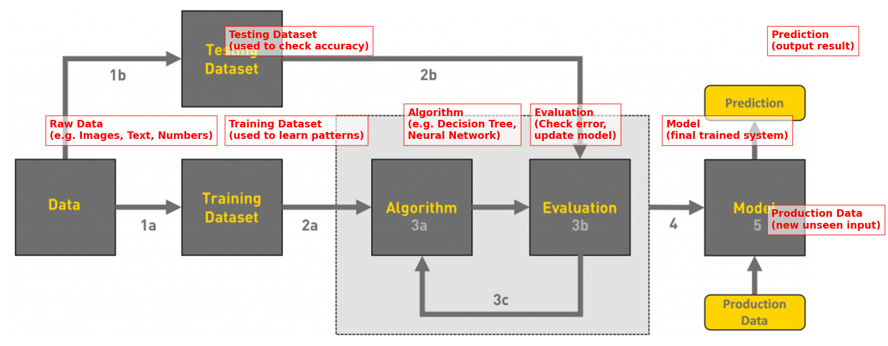
Workflow of ML tasks

Slide 16
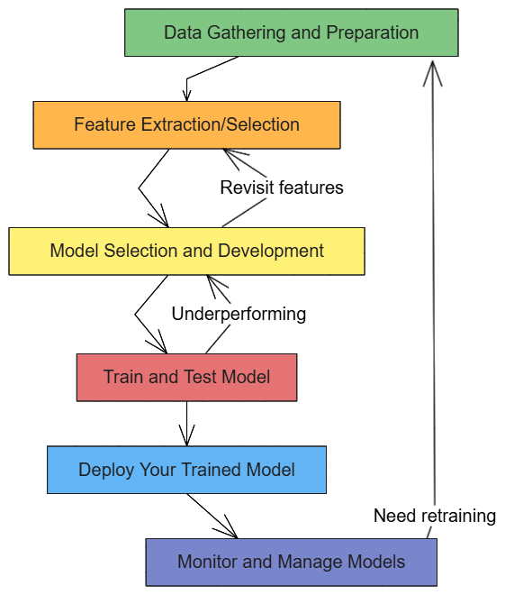
Workflow of ML Problem
The process of machine learning typically involves the following key steps:
Data Gathering and Preparation
Feature Extraction/Selection
Model Selection and Development.
Train and Test model
Deploy your trained model.
Monitor and Manage models

Slide 17
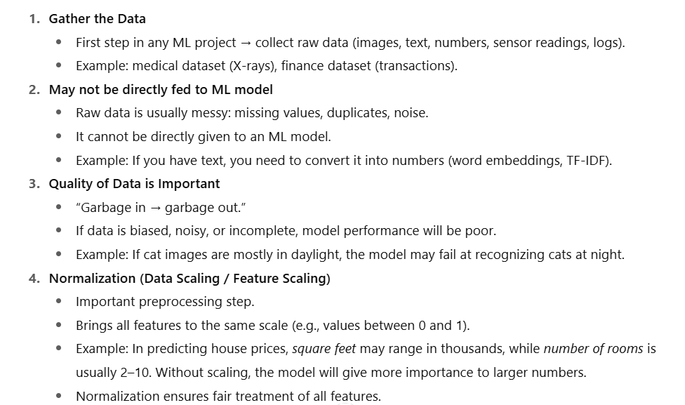
Workflow of ML Problem

Slide 18
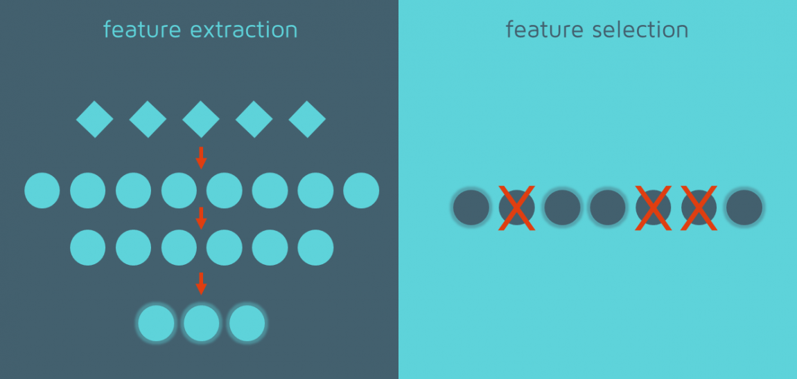
Workflow of ML Problem
Definition (feature selection and extraction)
Process of identifying the most important and relevant features (attributes) from the dataset.
Removes unnecessary or redundant data.
Why it’s needed?
High-dimensional data (too many features) → slow training, risk of overfitting.
Selecting key features makes the model faster, simpler, and more accurate.
Used for Training
Only selected features are used to train the machine learning model.
Example: In predicting student performance, features like study hours and attendance are useful, but favorite color is irrelevant.
Improves Performance
Better accuracy.
Less computation cost.
Easier to interpret results.

Slide 19
Model Selection and Development
What kind of data you have?
Select model accordingly.
Supervised or Unsupervised
Classification or Regression
Time series data or Image Data
Textual data
Develop your model using established ML techniques
Scikit-Learn
Keras/Tensorflow

Slide 20
Train, Test and Evaluate model
Why Split the Data?
ML models should not just memorize (overfit).
To check if the model generalizes, we divide the dataset into three parts.
Training Dataset:
Used to train the model (fit weights/parameters).
Example: Giving the model cat and dog images to learn patterns.
Validation Dataset:
Used to tune hyperparameters (like learning rate, number of layers, epochs).
Helps prevent overfitting by checking performance during training.
Example: Adjusting how “fast” the model learns to avoid underfitting/overfitting.
Test Dataset:
Used only once after training is complete.
Tests model’s performance on unseen data.
Example: After training a spam filter, test it on a fresh set of emails that were not part of training or validation.
Training | Validation | Test

Slide 21
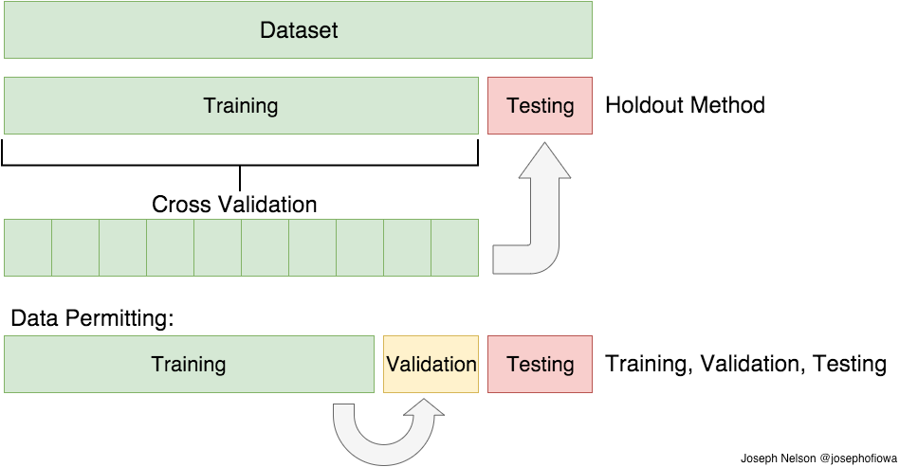
Training, Validation and Testing Data

Slide 22
Train, Test and Evaluate model
Cross-Validation
Set aside some portion of the data for validation and Train on rest of it.
LOOCV (Leave One Out Cross Validation)
Perform training on the whole training data set but leaves only one sample for validation
K-Fold Cross Validation
The data-set into split into k subsets(folds)
Perform training on the all the subsets but leave one(k-1)
Iterate for all folds

Slide 23
Monitor and Manage models
Monitor the predictions on an ongoing basis.
Manage your models and model versions
New models with versions numbers

Slide 24
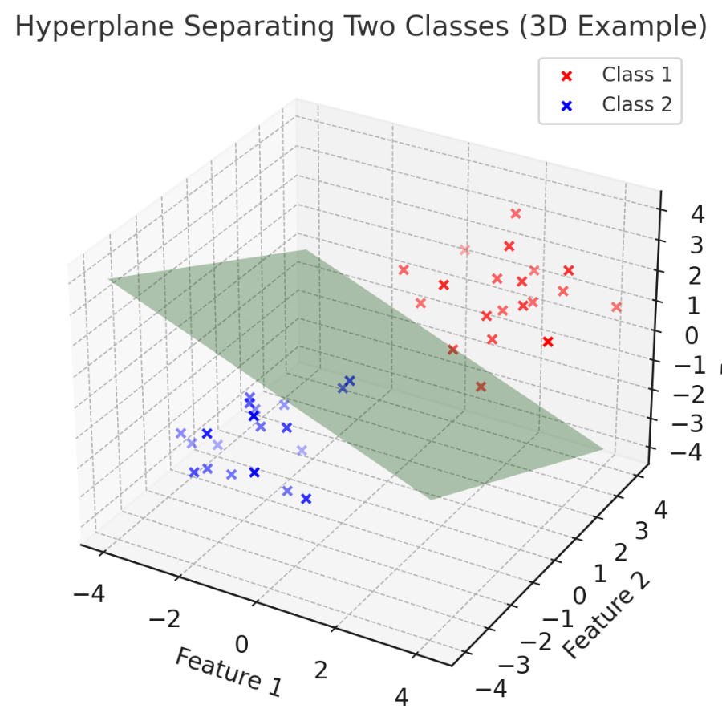
Linear models for learning
An assumption is linear separability:
in 2 dimensions, can separate classes by a line
in higher dimensions, need hyperplanes
A linear model is a model that assumes the data is linearly separable

Slide 25
Which line will it find?

Slide 26
Which line will it find?
Only guaranteed to find some line that separates the data

Slide 27
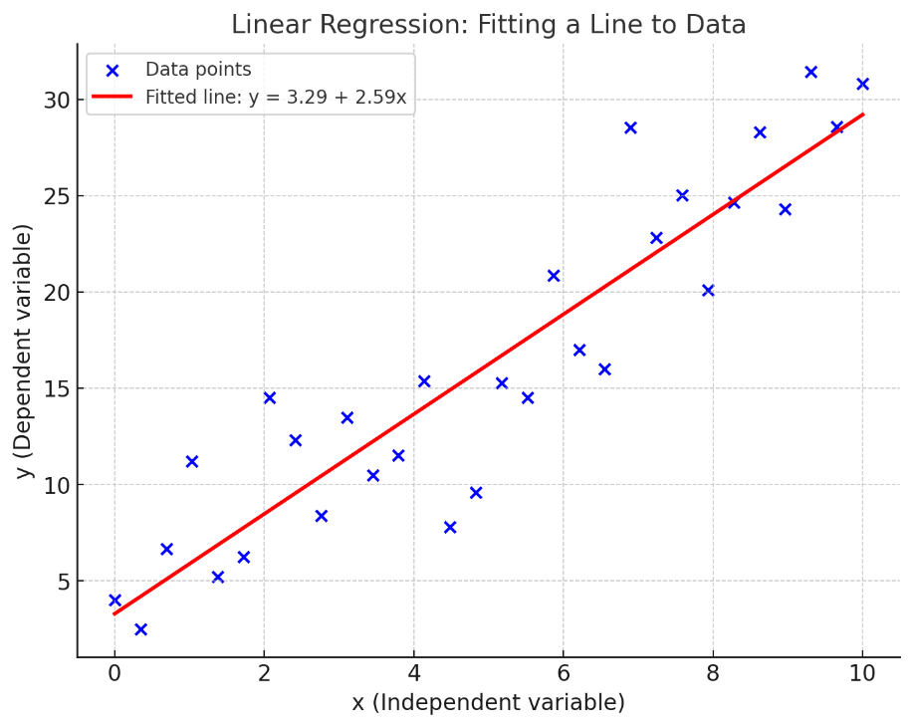
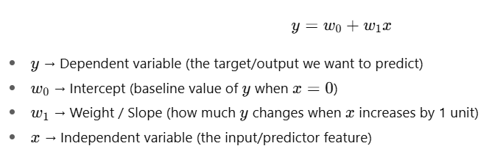
Linear regression
The goal of simple linear regression (univariate) model is to finds the relation between two variable.
A single feature (variable x) and a continuous valued response (target variable y).
X is called independent variable (predictor)
Y is called the dependent (target or response) variable.

Slide 28
Linear regression
The weight w₀ represents the y axis intercepts and w₁ is the coefficient of the feature (x variable).
w₀ and w₁ are unknown
The goal of linear regression is to learn the weights of the linear equation
Describe the relationship between the x and y
Then this relation can be used to predict the responses of new data

Slide 29
Linear regression
Linear regression can be understood as finding the best-fitting straight line through the sample points.
This best-fitting line is also called the regression line.
The distance between the regression line to the sample points are the so-called offsets or residuals
The errors of our prediction.

Slide 30
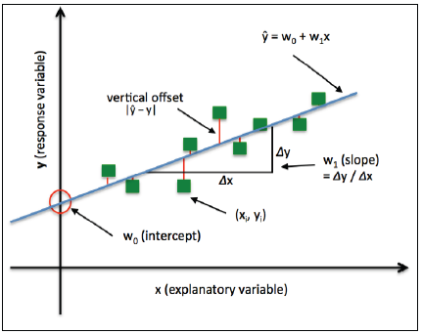
Linear regression

Slide 31
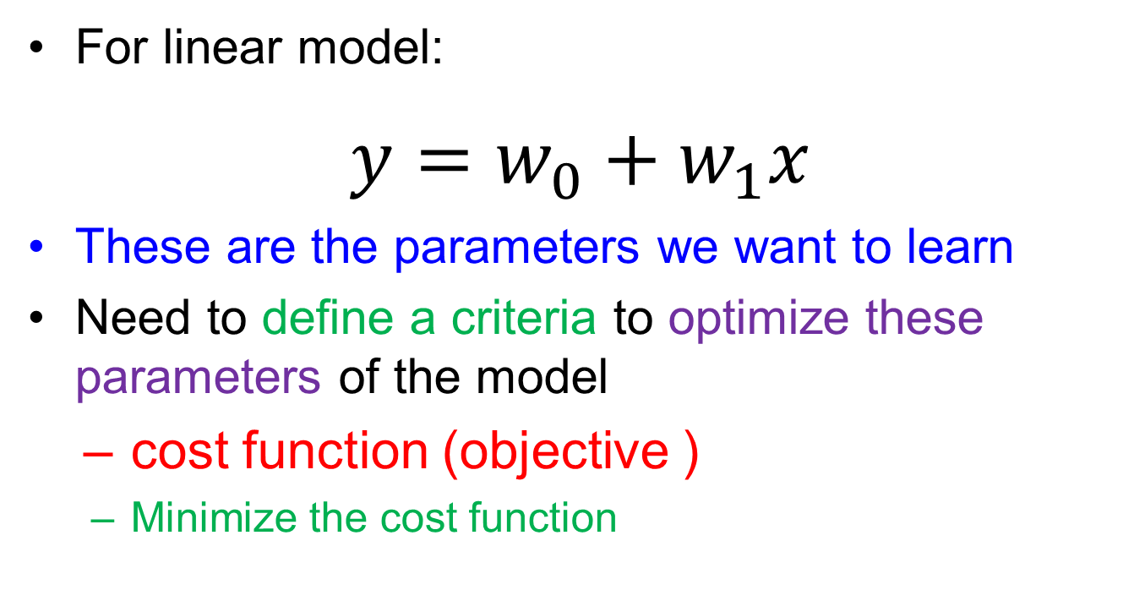
Linear models in general
For linear model:
$$y=w_{0}+w_{1}x$$
These are the parameters we want to learn
Need to define a criteria to optimize these parameters of the model
cost function (objective )
Minimize the cost function

Slide 32
Thank You ☺

